Slide 1
SwiftUI
Part 1 – UI Component View & Layout, Part 1
iCodeWave Community

Slide 2

Today’s Agenda
Things You Need to Know
Modifier
Text
VStack
HStack
ZStack
TextField
Button
Form
List
iCodeWave Community

Slide 3
Things You Need to Know
Before Jump In and Code
SwiftUI has two type of modifiers: internal and global modifier
Internal modifier typical is parameter of UI Component View and can not be used in another View
Global modifier is a View modifier that can be used in almost (not all) any View
Output preview always depends on modifier placement position
iCodeWave Community

Slide 4

What is Modifier?
To customise current UI Component View, whether is logical business modifier (eg: task, on appear, gestures, etc) or UI design modifier (padding, foreground style, background style, etc)
Usually put below current View
iCodeWave Community

Slide 5
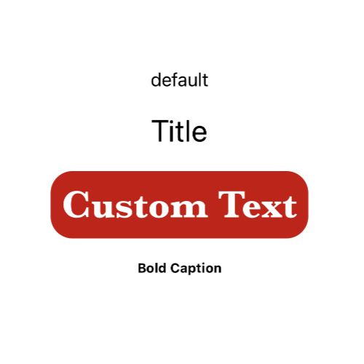
SwiftUI Views
Text
To output a text
To inform something to screen
Use global modifier properties to customise the look of a text
iCodeWave Community

Slide 6
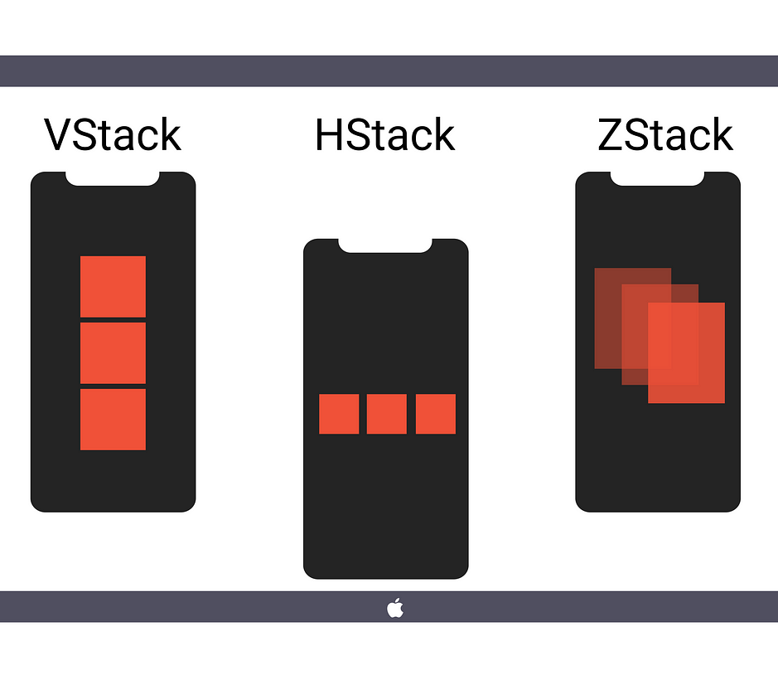
UI Component Layout:
Stacking
Understanding the difference between stacking methods
iCodeWave Community

Slide 7
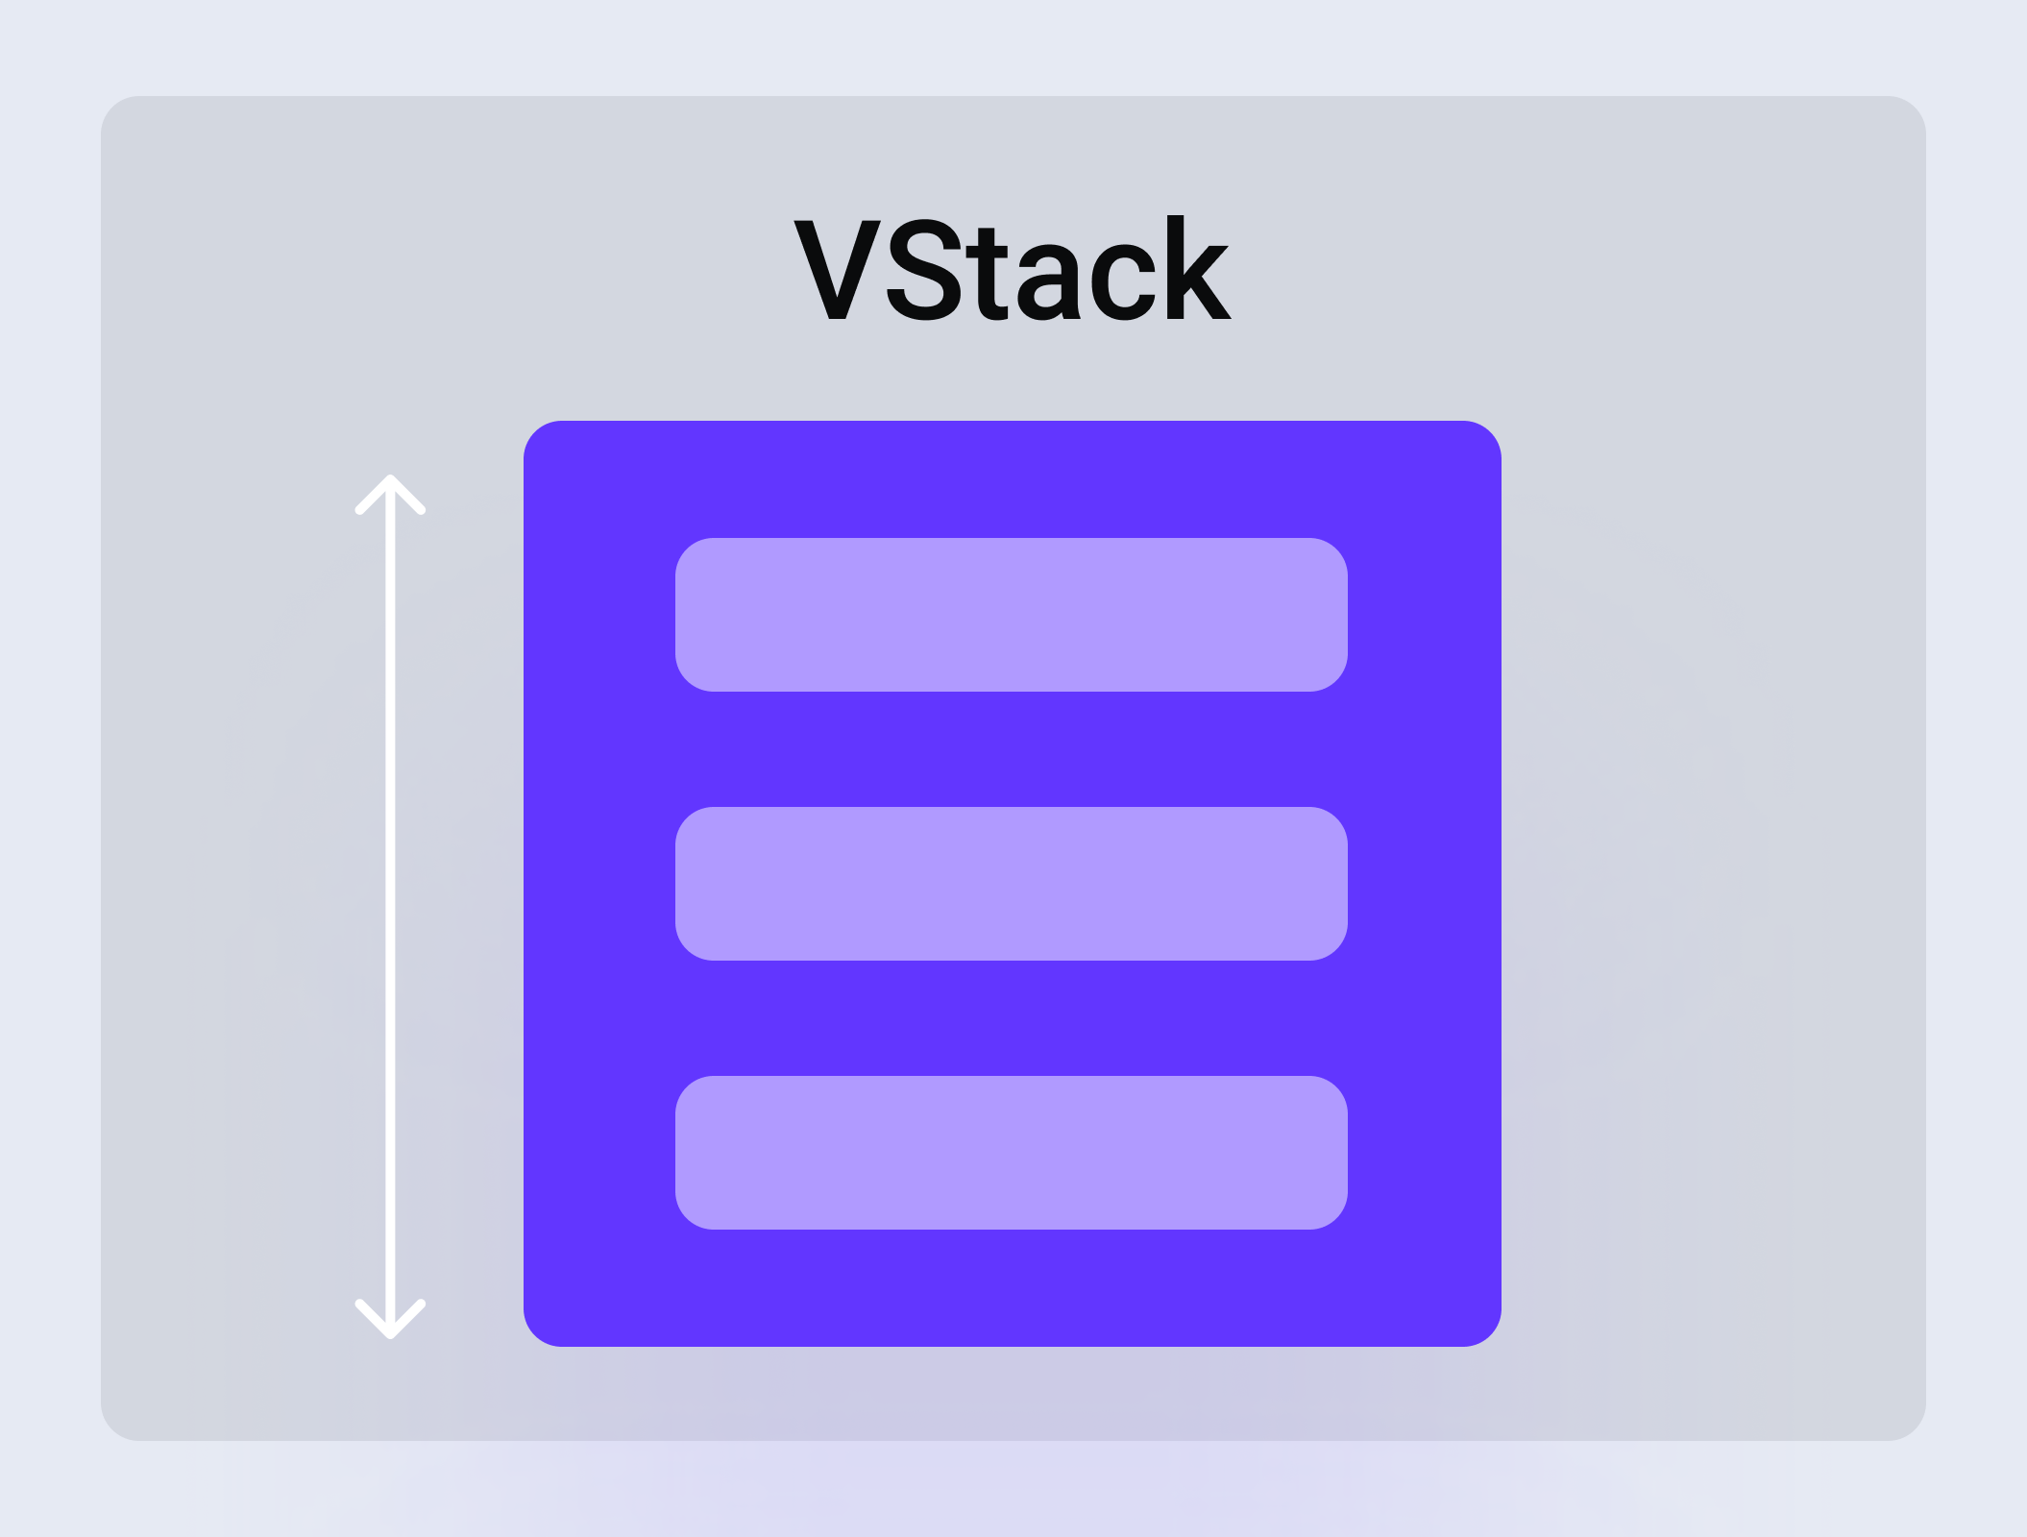
SwiftUI Views
VStack
To make Views stacking vertically
Use internal modifier parameter to change VStack behaviour (eg: alignment and spacing)
Use global modifier parameter to change VStack content entirely
iCodeWave Community

Slide 8
SwiftUI Views
HStack
To make Views stacking horizontally
Use internal modifier parameter to change HStack behaviour (eg: alignment and spacing)
Use global modifier parameter to change HStack content entirely
iCodeWave Community

Slide 9
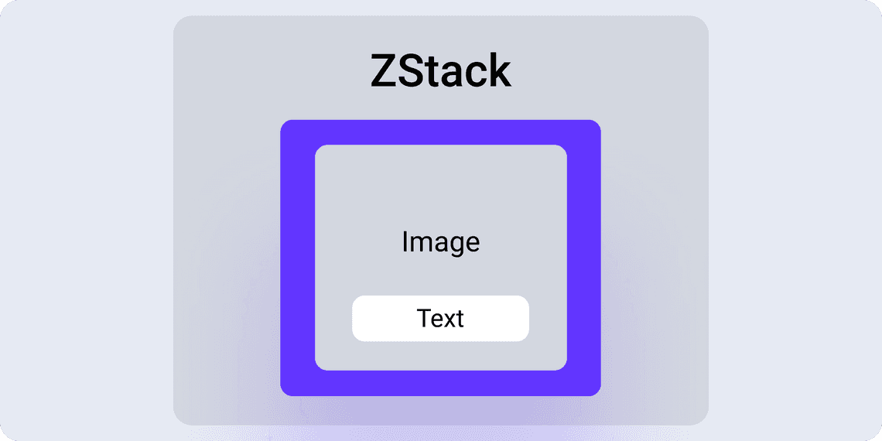
SwiftUI Views
ZStack
To make Views stacking overlappingly
Use internal modifier parameter to change ZStack behaviour (eg: alignment and spacing)
Use global modifier parameter to change ZStack content entirely
iCodeWave Community

Slide 10
SwiftUI Views
TextField
To make user input something into screen
Don’t forget to bind the text into property wrapper
iCodeWave Community

Slide 11
SwiftUI Views
Button
To perform an action when user interact with Button
There are 3 template to take: Plain/borderless, bordered, and bordered prominent
Don’t forget to fill the closure of action to trigger what will happened when user interact
iCodeWave Community

Slide 12
SwiftUI Views
Form
To make a simple form
Form are just a wrapper for another View
User can add almost any View inside of Form
You can use header or footer to add information
Or… use section to separate between columns of form
iCodeWave Community

Slide 13
SwiftUI Views
List
To make a scrollable content
By default scroll behaviour is vertical
You can also add footer and header into the list
To separate between columns, you can also add Section
iCodeWave Community

Slide 14
SwiftUI Views
List vs Form what’s the difference?
In macOS there’s a difference in a appearance
iCodeWave Community

Slide 15
SwiftUI Views
List vs Form what’s the difference?
In iOS & iPadOS, there’s no difference between them. Use them freely as you like
iCodeWave Community

Slide 16
Thanks For Your Attendance Today!
iCodeWave Community

